Slide 1
One Automation for GRT Actuals
10/21/2019

Slide 2
Team Members
Rutuja Pude
Kavita Panday
Darshini Shah
Aditya Bagbande
Deepak Dherange
Murlidhar Bagare
Madhuri Nirmale

Slide 3
PI-2 Features Completed
Feature | Number of User Stories | User Story Categories | Story Points
Create One Automation process for GRT Validation actual processing | 39 | Setup of the environments Domestic Validations International Validations GFBO Utility One Automation Flow | 154

Slide 4
Topics
GRT Actuals Process Flow
Current Process v/s Process in 1A
Business Value
Demo

Slide 5





GRT Actuals Workflow Overview
Intl Rate Ship
Dom Rate Quote
Details
Extract $ amount from invoiced shipments.
SQE Team provide this rated data to GRT for validation in one summary table
Retrieve/Pull data from PARS, DLRS, PDF, EDI & GFBO
It’s a complex process & multiple methods/tools being used for extracting data
Perl/Shell Scripts, PL-SQL Stored procedures, Mainframe Jobs, UFT/Selenium scripts, Java utility.
Rated Data
Final Data
Summary
Expected
Process
GRT Test Data
Load DB
Actuals
Process
DB2 data
With JCL
PDFs
MMA
Files (AMB, INV
EDI)
PARS Data
FDS
GFBO
Distributed
Systems

Slide 6
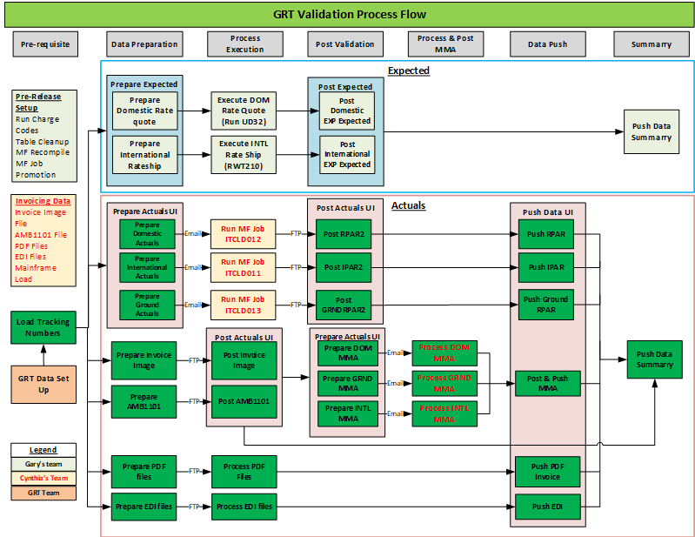
GRT Validation Process Flow

Slide 7
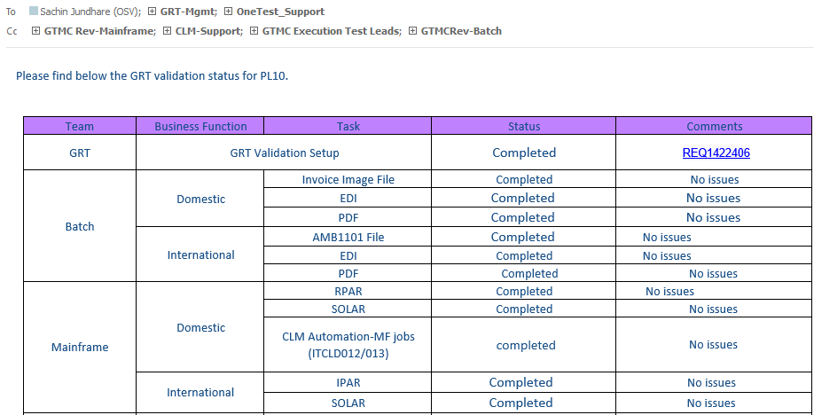
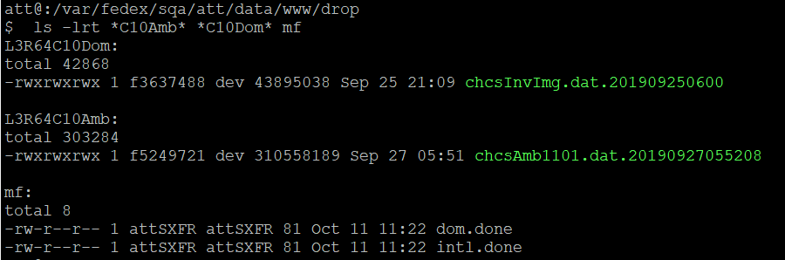
Current Process vs 1 Automation
Current Process
Dependency on Invoicing Email Notification
1 Automation
1A Scripts smart checks if the necessary invoiced data present

Slide 8
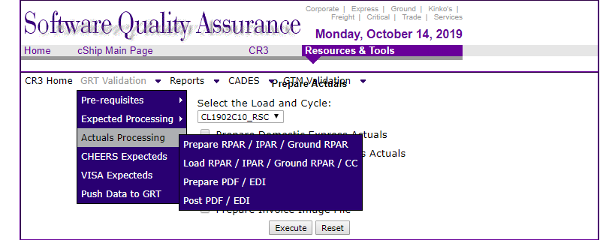
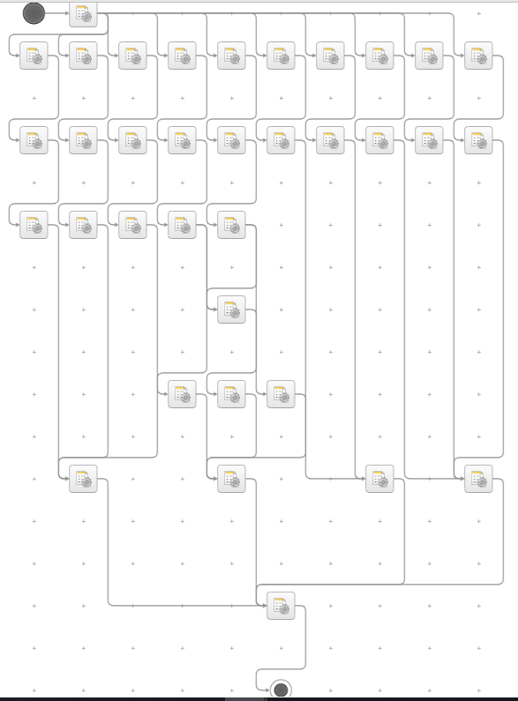
Current Process vs 1 Automation
Current Process
Execution From the GUI
1 Automation
1 Click Execution

Slide 9
Current Process vs 1 Automation
Current Process
Data Check on External/Result Tables by Query Execution on the Databases.
GFBO data Extraction using QTP Script
Sending emails for Duplicates, MF Job Runs,
GFBO Script run
1 Automation
1A Scripts smart checks the data(record count) and the creators in the Tables
GFBO Data Extraction using Selenium Utility
Outgoing emails sent by 1A Scripts when needed

Slide 10
Business Value
Current GRT Actuals Execution
Manual intervention
Prone to human errors
Needed dedicated support for the Actuals Execution
Approx. 1.5 resources time goes into execution & supporting GRT Actuals validation
1A GRT Actuals
Manual intervention eliminated to a great Extent
Less human errors.
Minimal support
Approx. 0.5 resources time will be needed

Slide 11
Demo

